Slide 1
e-Learning 2025
Edunova KILT e-Learning
invites you to participate in our 2025 e-learning competition
“Going dieper with Tech”

Slide 2
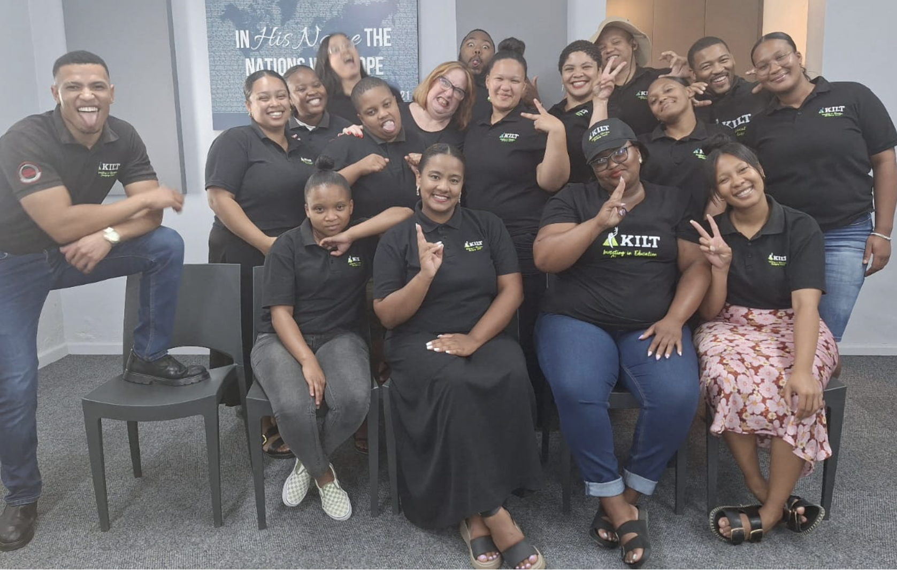
Edunova KILT e-Learning
invites you to participate in our 2025 e-Learning Competition
“Going “dieper” with Tech”

Slide 3
Get your School Diep team together!
ICT coordinator (support)
5 Diep teachers must:
Have laptop and Data
Be willing to learn and share
Not scared to use tech
Attend all compulsory sessions
In it to win it!!!!
Get to School Target: R5000
DIeP teacher Team

Slide 4
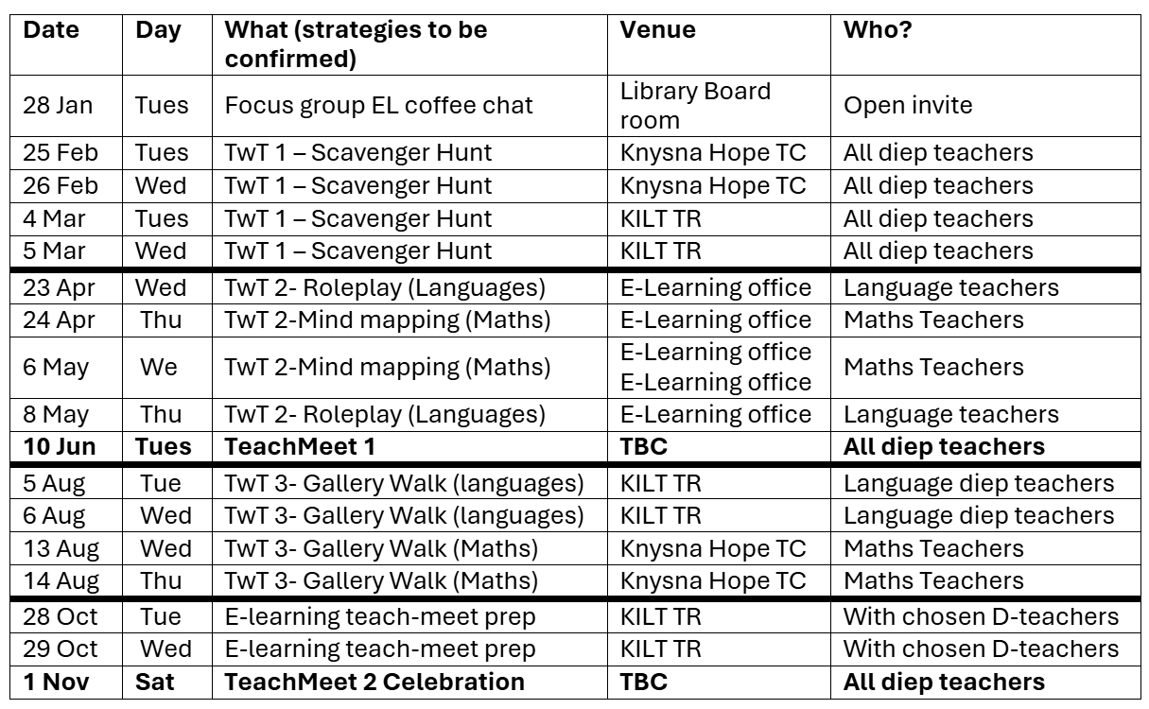
Overview
Plan 4 e-lessons
Interschool – buddies
School Based – Grade diep peers
1on1 ITEs – (H)App(y) + skills
1on1 Maggie – Lesson support
Implement (4)
- Lesson plan
Recordals of e-lesson
Lesson material & Tech & video
Lesson media
ITEs support
TwT
Attend 3 (Interschool)
Labtech
Attend 3 (School Based)
Lesson plan
Apps & tools
Evaluation & feedback
- Self evaluation rubric
Peers → Lesson study
Peer evaluation Rubric
(Interschool, School Based or 1on1 M)
Curriculum
Teachmeet (2)
Show off
E-lessons
Apps and skills
= Prizes
Badges (10)
3 TwT, LabTech, Wakelet, Collaboration,
AI, PowerPoint, Video

Slide 5
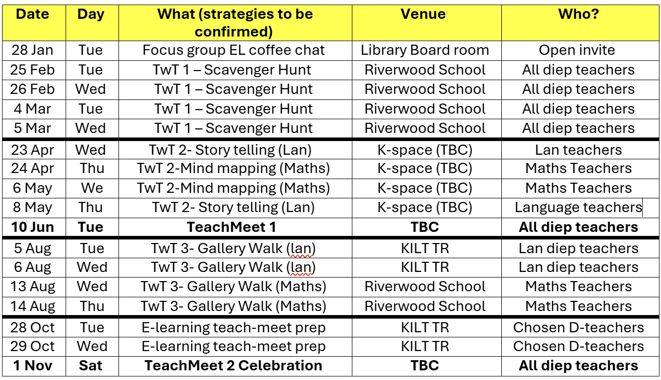
TwT
Attend 3 (Interschool)
Labtech
Attend 3 (School Based)
3 x 100pts
= 300pts /D-Teacher
1500/D-team +
2pts/ND teacher

Slide 6
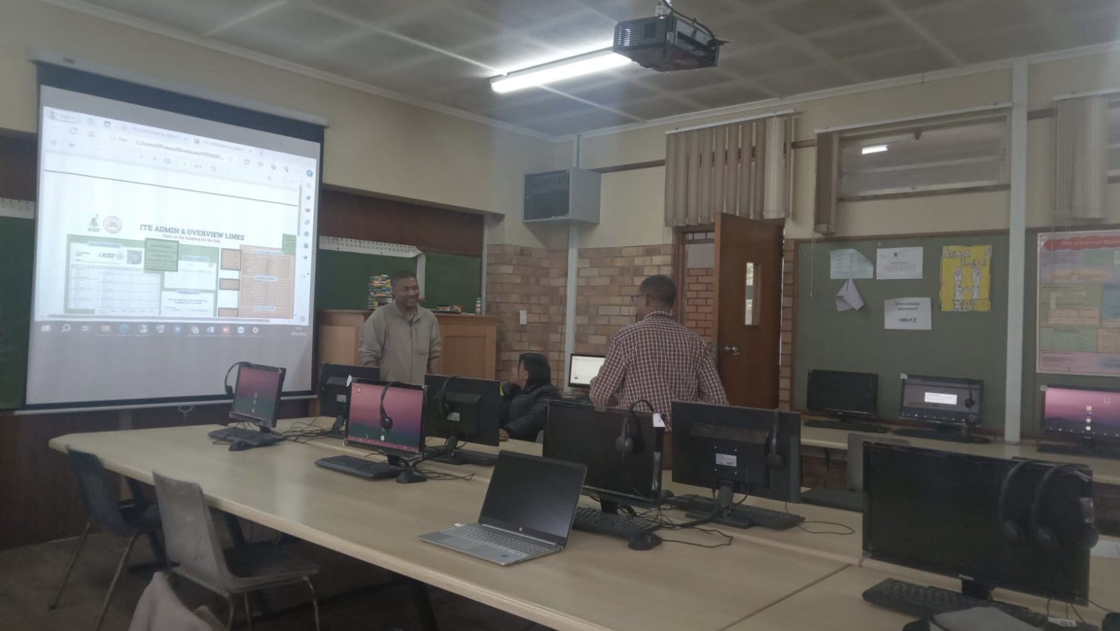
Labtech
Attend 3 (School Based)
Labtech (3 workshops)
Who: All Diep teachers (5)
What: School based, afterschool
When: Organise with ITE (and Tech Team) for suitable dates in term 1 and 2.
Content:
Session 1: Lab use and management (40 pts)
Session 2: Device use and trouble shooting (40 pts)
Tech theory and practical assessment (100 pts)
Dieper:
If you need more practice- 1 on 1 with ITE (5pts)
Session 3: A practical and theory assessment. (100pts)
2 x 40 + 1 x 100
= 180/D-Teacher
= 900/D-team
Plan e-lesson (8)
Interschool – buddies (4)
School Based – Grade diep peers
1on1 ITEs – (H)App(y) + skills
1on1 Maggie – Lesson support
Lesson plan
Apps & tools
Curriculum

Slide 7
Plan e-lessons
Interschool – buddies
School Based – Grade Diep/peers
1on1 ITEs – (H)App(y) + skills
1on1 Maggie – Lesson support
Who: All Diep teachers (5)
What: Plan your Diep lesson plan and earn points!
How?
Meet with your ITE to guide them on what tech they can suggest during a 1 on 1 support session (5 pts/1on1)
Organise School Based Diep lesson planning session with
the other Diep teachers/peers in your school, grade, subject…. (10 points/DT– group session)
Organise an Interschool lesson planning session with Diep teachers from other schools (Buddie up) (20 points/teacher + 5 points more for host school)
Meet with Maggie 1 on 1 for feedback and lesson support (team/office- coffee provided)
Implement (4)
- Lesson plan
Recordals of e-lesson
Lesson material & Tech & video
Lesson media
ITEs support
Lesson plan
Apps & tools
Curriculum
School Based: 10 pts/D-teacher
Interschool: 20pts/DT + 5pts for host school (skills workshop)
ITE 1on1: 5 points
Maggie: 20 pts

Slide 8
Implement (4)
- Lesson plan
Recordal of e-lesson (ITE)
Lesson material & Tech & video
Lesson media
ITEs support
Who: All 5 Diep teachers and ITEs
Make sure that your lesson plan is ready to roll!
Book your ITE to be with you and support you during the lesson!
ITE will help to record the lesson (webcam, audio and photos) and provide in class support.
After the lesson:
Reflect on the lesson and add to your lesson plan (what worked, didn’t, possible changes)
Add all lesson material into your G-folder
Do a voiceover talk-through of your lesson PowerPoint and export as video (add 2 folder) → Earn your PowerPoint, Video and TwT strategy badge.
Implementation: 100 points
TwT Badge for strategy used (Scavenger hunt – Team, roleplay, storytelling, mind mapping, gallery walk, MCO)
Evaluation (8)
- Peers → Lesson study
Rubric
(Interschool, School Based or 1on1 M)

Slide 9
Evaluation and feedback
- Peers → Lesson study
Rubric
(Interschool, School Based or 1on1 M)
Who: All Diep teachers
What:
We will develop a fair rubric together to assist and direct us.
Reflect on your lesson plan, complete self assessment rubric (what worked, did not, and what you would change)
Your lesson plan and video will be shared anonymously with another Diep teacher and Maggie for feedback.
We may use your lesson for lesson study (Interschool, school based)
You can ask for a 1on1 feedback session with Maggie
The top e-lessons will present at the Teachmeets
Self evaluation rubric : 5 pts Peer feedback: 10 pts Maggie: 20 pts (4 lessons)
Badges (10)
3 TwT, LabTech, Wakelet, Collaboration,
AI, PowerPoint, Video and MCO (Maths) or Free reading programme or Create a story (lan)

Slide 10
Badges (10)
3 TwT, LabTech, Wakelet, Collaboration,
AI, PowerPoint, Video and MCO (Maths) or Language Badge
Teachmeet (2)
Show off
E-lessons
Apps and skills
= Prizes
Who: All Diep teachers 10 badges
What: Earn your 10 compulsory badges!
How:
Make sure that you adhere to the criteria for each badge (see bit.ly/kbadges)
If there is more than one of you, or other teachers who want to learn, organize a app/skill school based or interschool workshop.
If you want some individual attention, book a 1 to 1 with your ITE.
All Badges MUST be USED during implementations
You can do extra apps and badges as well (2pts)
Enter the TeachMeet APP-Smash (2x a year and win spot prizes!
Compulsory Badges: 20 points
Other app Badges: 2 pts
Interschool workshops: 40+5
School based workshops: 20
1on 1’s: 5 pts

Slide 11
Teachmeet (2)
Show off
E-lessons
Apps and skills
= Prizes
Who: All Diep teachers
What: A Teachmeet is a sharing session where we showcase our e-lessons and the apps we used.
1 in the middle of the year (5 June) and a celebration at the end of the year (1 Nov)
5 Diep e-lessons (Chosen top lessons)
App smash of apps that you used innovatively in your lessons.
How:
The 5 best scoring e-lessons will present. (All 5 get prizes)
Enter your apps-mash – the 5 submitted present for prizes.
What | Time, # /session | Kilt Leaderboard* | PTS Per Diep teacher (DP) | Per school team | Comments /Instructions
3 TwT afterschool Interschool sessions | 2h → 3 Sessions | Interschool * | 3 x 100 (+2) | 1500 =2 x # | Each TwT session will present a new strategy which have to be implemented within the next month. There will be 4 different sessions to choose from to make sure that teachers do not miss a session. Bookings are essential and -20 pts if you do not pitch if you have booked! Sessions are restricted to 20 people. Non-diep teachers can come and earn pts for their schools (5 pts) provided there is space.
3 Tech-lab School based after school sessions | 2h→3 | School Based * | 2 x 40 +100 | 900 | Schools have to organize the dates and get the ITEs to let the Tech team know. The last session (pick a suitable date in June) will be a theoretical and practical exam
School Based after school groups sessions | ½h or 1h or 2h → 12 Sessions | School Based* | 10 | 25 (+2NDP) | Do lesson planning sessions with your team and/ or non-Diep school grade colleagues App and skill workshops with peers (2 school pts per non-Diep teacher)
Inter school sessions (after school) |  | Interschool* | 20 40 (F) | +5 (host) | Do lesson planning sessions with your e-learning buddies at other schools (2/more people). Host school get 5 pts extra. Or come and do it at our k-space (less than 10)-just book space. Do app and skill workshops (or ask ITE to do it) Invite the other schools! Facilitator gets 40, Diep teachers get 20 and non-Diep teachers 5.
1 on 1s with ITEs |  | 1 on 1 | 5 |  | Schedule with ITEs (See ITE at least 2 x a month or more!) use for lesson plan, support or badges
1 on 1’s with Maggie |  | 1 on 1 | 30 | = 30 x 4 x 4 | Schedule with Maggie (See her at least 4 times) Via Teams, Google meet or at the K-space!
Badges | 10 | Any of the above | 20/badge |  | Compulsory badges 20pts and other badges 2 (must be used actively in the class)
Teach meet2 (after school) | 2h / 4h → 2 Sessions | Interschool* | 200 30 + prizes 20 + prizes | 1000 + | All Diep teachers should be there! 5 E-lesson presenters 30pts +prizes 5 App smashers 20 pts + prizes
4 Diep e-lessons | 4 lessons |  | 4 x 100 | 2000 | Complete folders with lesson plan, lesson material, ppt, rubric, recording and lesson video
e-PLC steering | ½→2h | Interschool* | 5 |  | Optional. Coffee chats, Brainstorming, Opportunities etc (notification via WA e-learning group)
Other ad hoc points | ½ , 1h, |  | 1-100 |  | Webinars, flash-mobs, jaribaaa opportunities , surveys, computer room, best Wakelet, etc……
Teachmeet Attendance 200pts
e-lesson present 50 pts
Teachmeet apps-mash 30 pts

Slide 12
Game points and rules
What | Time, # /session | Kilt Leaderboard* | PTS Per Diep teacher (DP) | Per school team | Comments /Instructions
3 TwT afterschool Interschool sessions | 2h → 3 Sessions | Interschool * | 3 x 100 (+2) | 1500 =2 x # | Each TwT session will present a new strategy which have to be implemented within the next month. There will be 4 different sessions to choose from to make sure that teachers do not miss a session. Bookings are essential and -20 pts if you do not pitch if you have booked! Sessions are restricted to 20 people. Non-diep teachers can come and earn pts for their schools (5 pts) provided there is space.
3 Tech-lab School based after school sessions | 2h→3 | School Based * | 2 x 40 +100 | 900 | Schools have to organize the dates and get the ITEs to let the Tech team know. The last session (pick a suitable date in June) will be a theoretical and practical exam
School Based after school groups sessions | ½h or 1h or 2h → 12 Sessions | School Based* | 10 | 25 (+2NDP) | Do lesson planning sessions with your team and/ or non-Diep school grade colleagues App and skill workshops with peers (2 school pts per non-Diep teacher)
Inter school sessions (after school) |  | Interschool* | 20 40 (F) | +5 (host) | Do lesson planning sessions with your e-learning buddies at other schools (2/more people). Host school get 5 pts extra. Or come and do it at our k-space (less than 10)-just book space. Do app and skill workshops (or ask ITE to do it) Invite the other schools! Facilitator gets 40, Diep teachers get 20 and non-Diep teachers 5.
1 on 1s with ITEs |  | 1 on 1 | 5 |  | Schedule with ITEs (See ITE at least 2 x a month or more!) use for lesson plan, support or badges
1 on 1’s with Maggie |  | 1 on 1 | 30 | = 30 x 4 x 4 | Schedule with Maggie (See her at least 4 times) Via Teams, Google meet or at the K-space!
Badges | 10 | Any of the above | 20/badge |  | Compulsory badges 20pts and other badges 2 (must be used actively in the class)
Teach meet2 (after school) | 2h / 4h → 2 Sessions | Interschool* | 200 30 + prizes 20 + prizes | 1000 + | All Diep teachers should be there! 5 E-lesson presenters 30pts +prizes 5 App smashers 20 pts + prizes
4 Diep e-lessons | 4 lessons |  | 4 x 100 | 2000 | Complete folders with lesson plan, lesson material, ppt, rubric, recording and lesson video
e-PLC steering | ½→2h | Interschool* | 5 |  | Optional. Coffee chats, Brainstorming, Opportunities etc (notification via WA e-learning group)
Other ad hoc points | ½ , 1h, |  | 1-100 |  | Webinars, flash-mobs, jaribaaa opportunities , surveys, computer room, best Wakelet, etc……

Slide 13
Diep Lesson?
Bit.ly/goingdieper25 (for more info)
CAPS/ATPS
Lesson plan
Peer/ITE/Maggie support
Choose tech
Create support material
Implement
Self reflect → Rubric
🤩 Active not passive
🤩 4 C’s
🤩 LEARNER CENTERED 🤩 SAMR
🤩 TPACK
🤩 Seamless Tech
Attention
Engagement
Consolidation
Feedback

Slide 14
Our collaboration spaces
Online Spaces
Diep Teachers Facebook group (Discussion, collaboration and resources)
Klearning Facebook page (Announcements and events)
Diep Teachers Whatsapp Group
K-Workspace
Queen Centre 1st floor, 19 Queen street, Knysna
Come and join us in the afternoon to do lesson planning 1on1s or
Work with other teachers to plan and discuss Diep lessons (group sessions)
Come and practice apps and skills
Computer help
Coffee
Resource sharing
Klearning.co.za
Wakelet.com/@klearning.co.za

