Slide 1
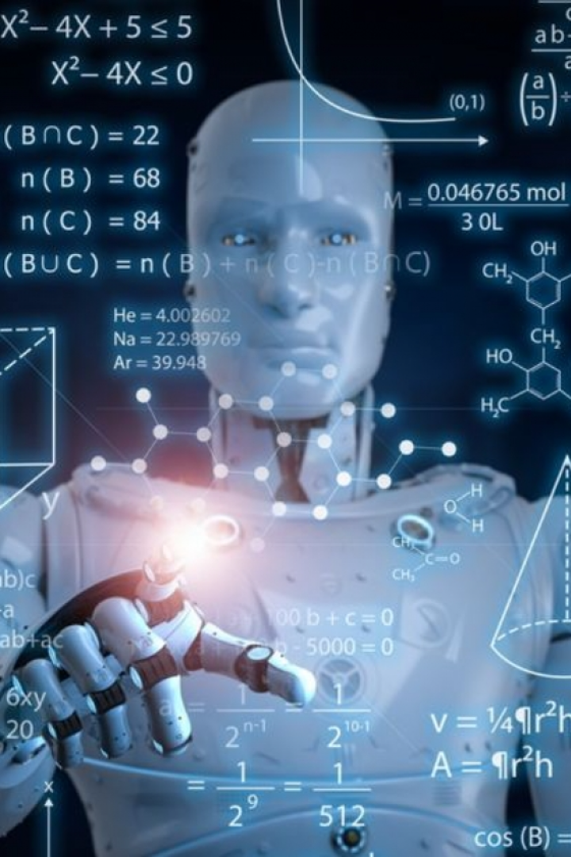
Hoe kan AI jou help in jou klaskamer en orals?
bit.ly/adaptordai
Doen jou lesplan vir jou
Maak jou hele PowerPoint vir jou in minute (baie funkie)
Al jou einde van die jaar leerder opmerkings
Self-merk toetse
Maak jou eie prentjies.
Speletjies en meervoudige keuse toetse met antwoorde
Skryf boeke in Afrikaans (met illustrasies)
………… en dit als in minute
Discover the transformative power of AI in education, its benefits, challenges, successful implementations, and future trends.

Slide 2
AI in Education
Discover the transformative power of AI in education, its benefits, challenges, successful implementations, and future trends.
bit.ly/adaptordai
Memory Dizha & Maggie Verster
ChatGPT- Create our workshop
Gamma- Create a slideshow

Slide 3
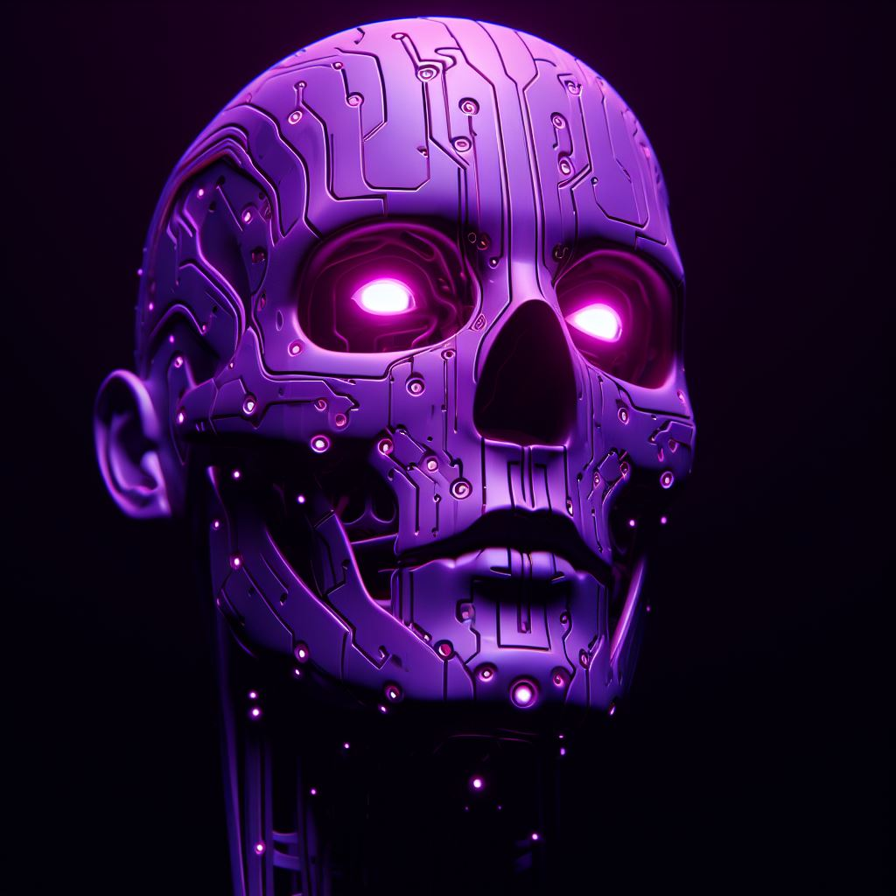
AI – Adapt or DAI

Slide 4
AI – Adapt or DAI

Slide 5
AI – Adapt or DAI

Slide 6
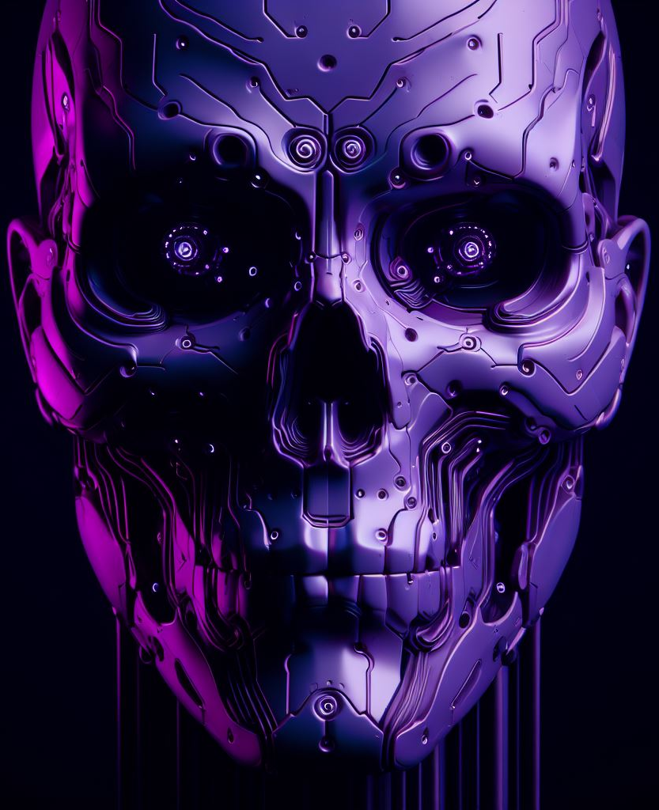
AI – Adapt or DAI

Slide 7
AI – Adapt or DAI

Slide 8
AI – Adapt or DAI

Slide 9
AI – Adapt or DAI

Slide 10
AI – Adapt or DAI

Slide 11
AI – Adapt or DAI

Slide 12
AI – Adapt or DAI

Slide 13
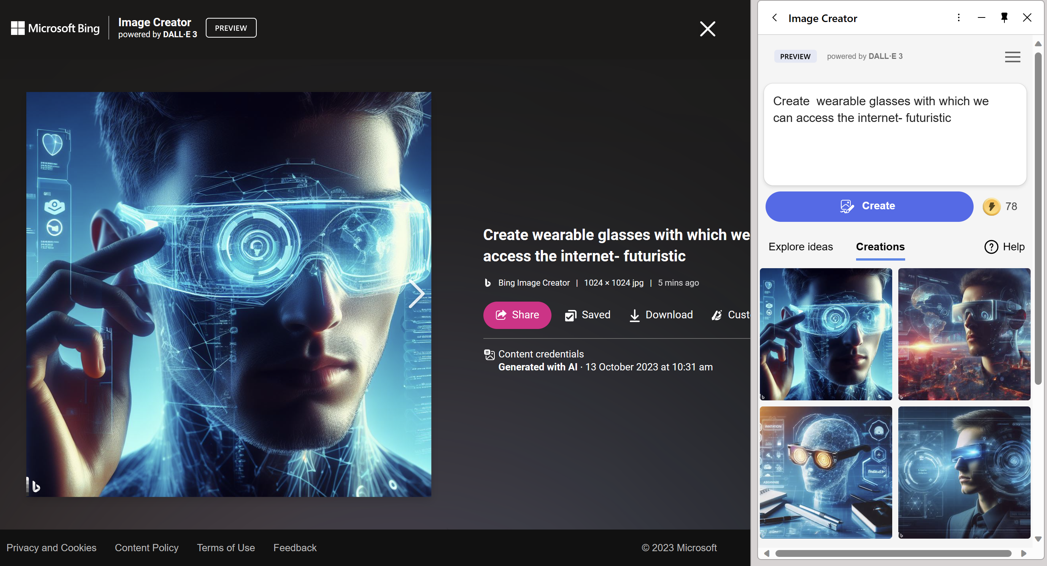
AI – Adapt or DAI
Go to image creator bing.com/create
Notes:
I am a teacher. Convince me that Ai is important for education as I am very skeptical. Give me example and tools that I can use that will make a difference to me as a teacher and my learners

Slide 14
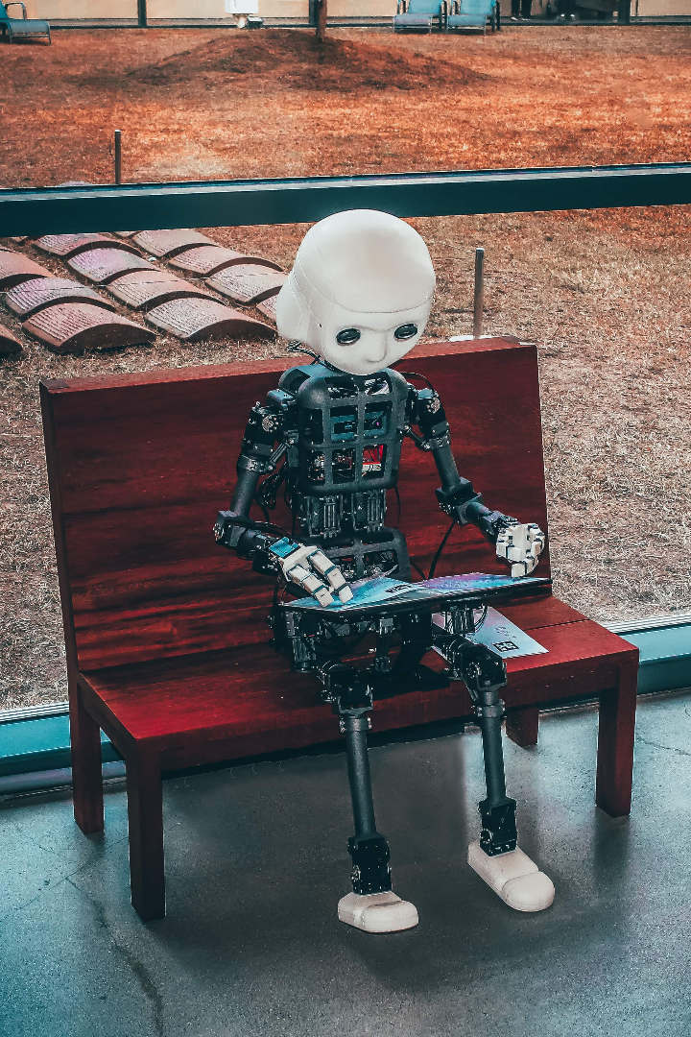
Definition of AI in Education
Augmented Learning
AI in education refers to the integration of artificial intelligence technologies to enhance the learning and teaching experience.
Go to CHATGPT and prompt it to tell you what AI is chat.openai.com

Slide 15
Benefits of AI in Education
1
Personalized Learning
2
Improved Assessment Methods
3
Enhanced Administrative Tasks
AI enables adaptive learning platforms that tailor education to the individual needs and abilities of each learner.
AI tools facilitate automated grading, providing instant feedback to students and freeing up teachers' time for more meaningful interactions.
AI streamlines administrative tasks such as scheduling, record keeping, and data analysis, improving efficiency and accuracy.
Photomath
Set a multiple choice test
Report comments

Slide 16
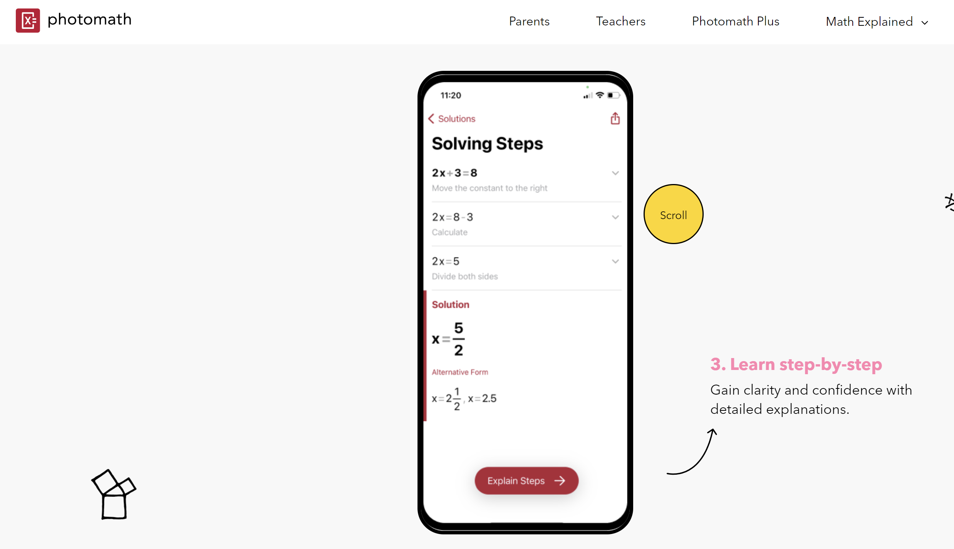
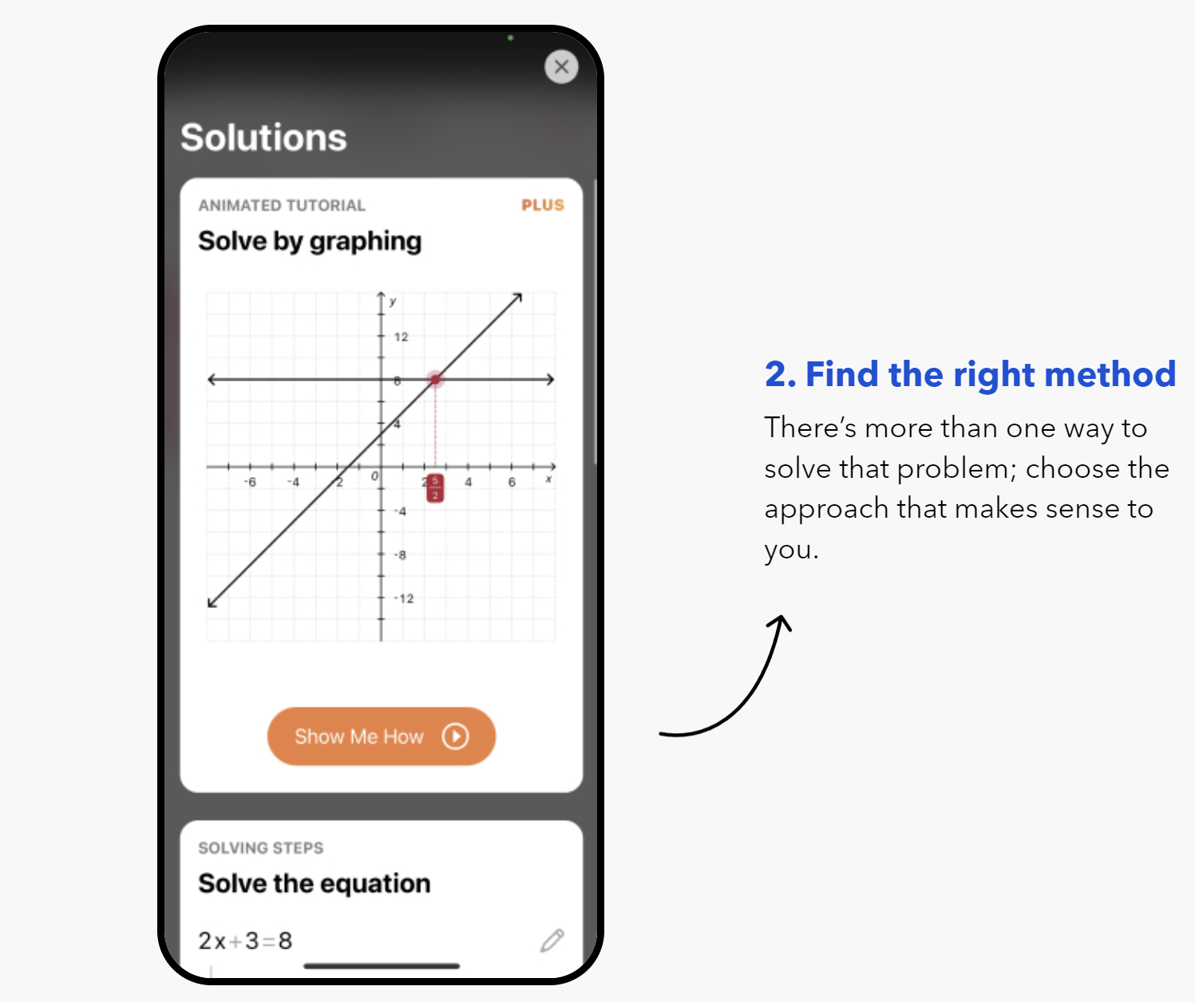
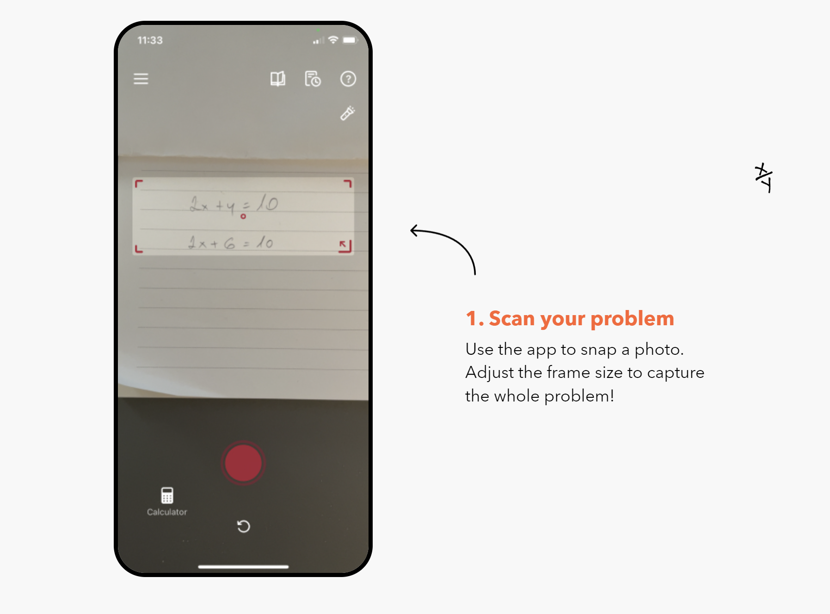

Slide 17
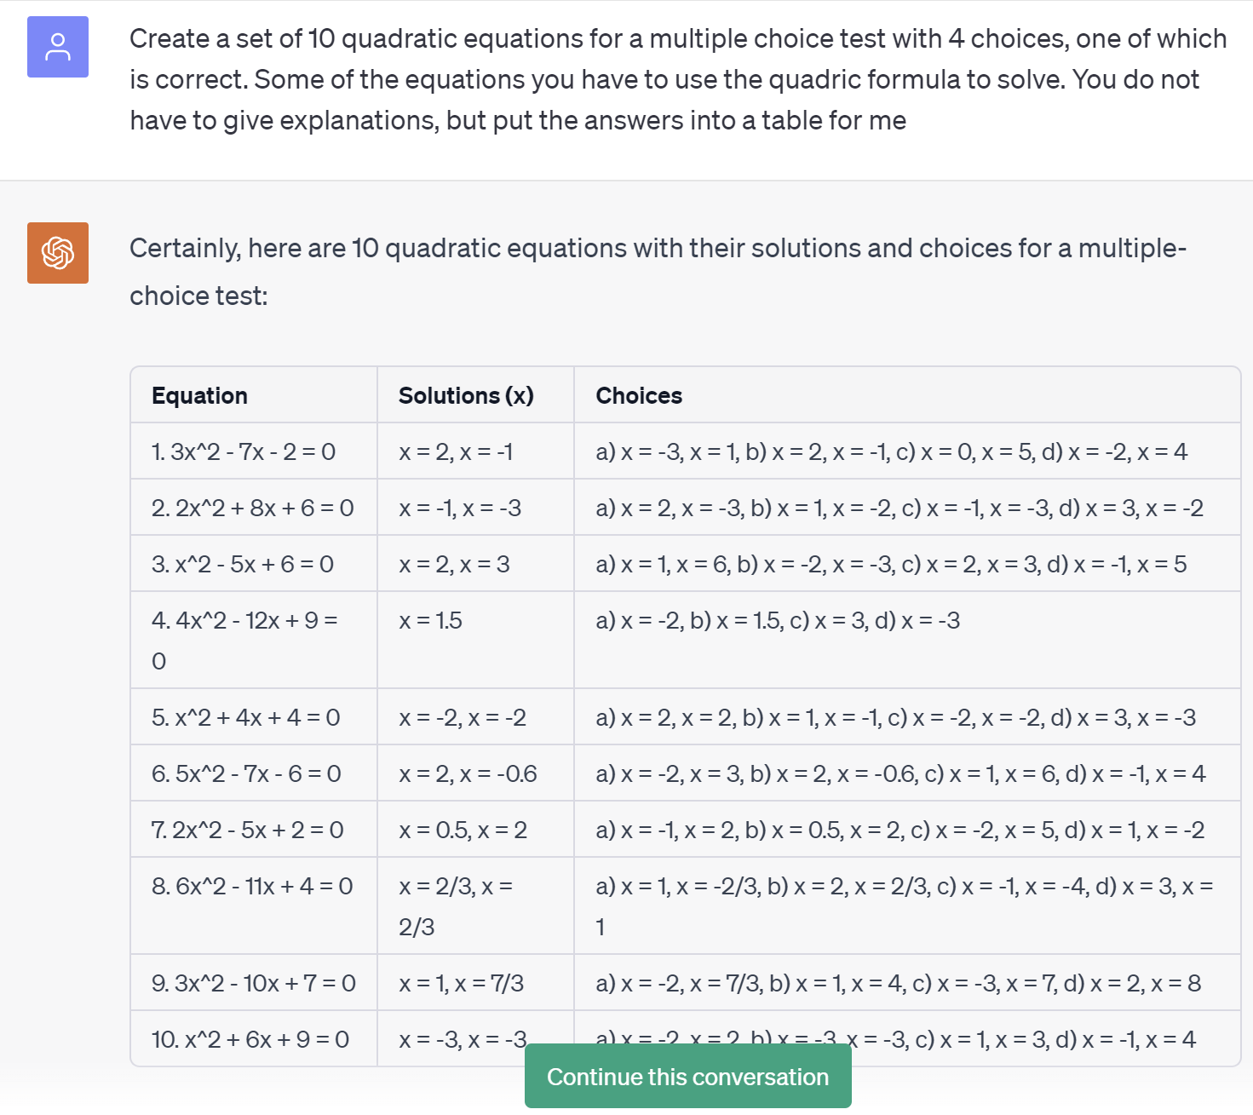

Slide 18
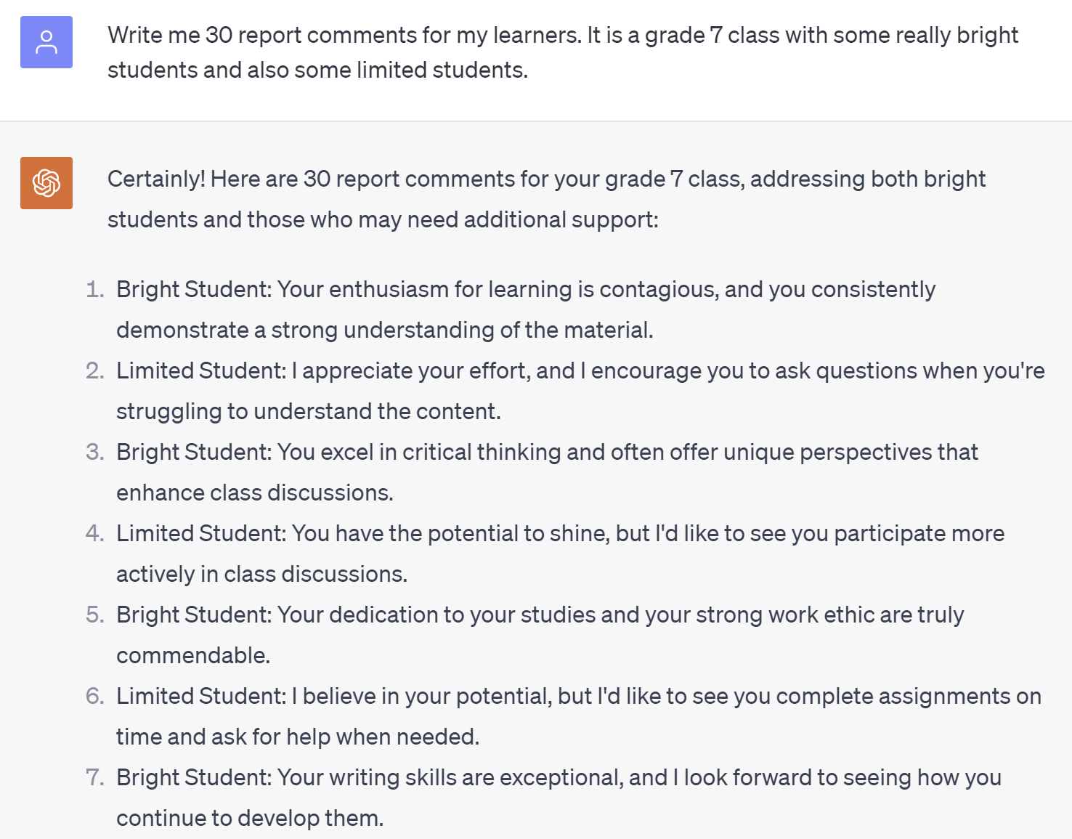

Slide 19
Benefits of AI in Education
4
Language Learning and Translation
5
Teacher lesson plan and resource assistant
6
Create quick course material
AI can break down language barriers and facilitate communication between learners from different linguistic backgrounds.
AI teacher tools can create lesson plans, flash cards role plays, assessment tools, games and more to make their classrooms more interactive in a flash!
AI makes it possible to create learning material in a a flash and make it accessible to learners using mobiole devices.
Duolingo
Eduaide.ai
Quick Excel course
AI course
Notes:
https://link.edapp.com/lbupwJHDKDb https://learningstudioai.com/share/bLDwA7rgJTxN3treHT2Z#quiz
https://www.edapp.com/course/getting-started-with-microsoft-excel/

Slide 20
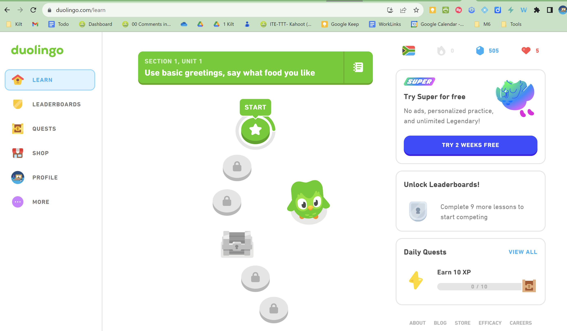
Notes:
https://schools.duolingo.com/

Slide 21
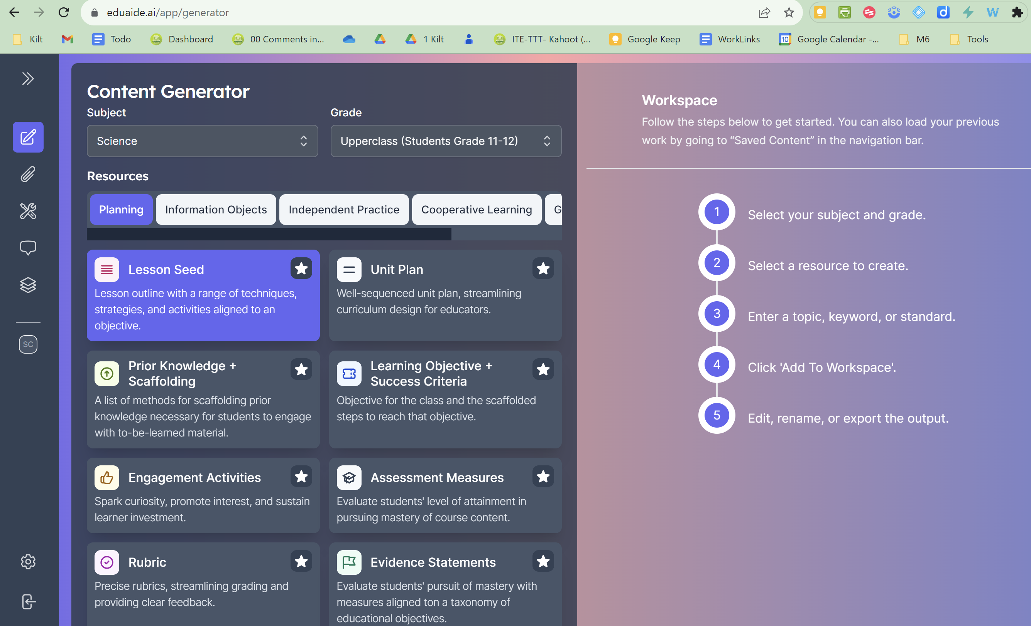

Slide 22
Notes:
https://www.edapp.com/course/getting-started-with-microsoft-excel/

Slide 23
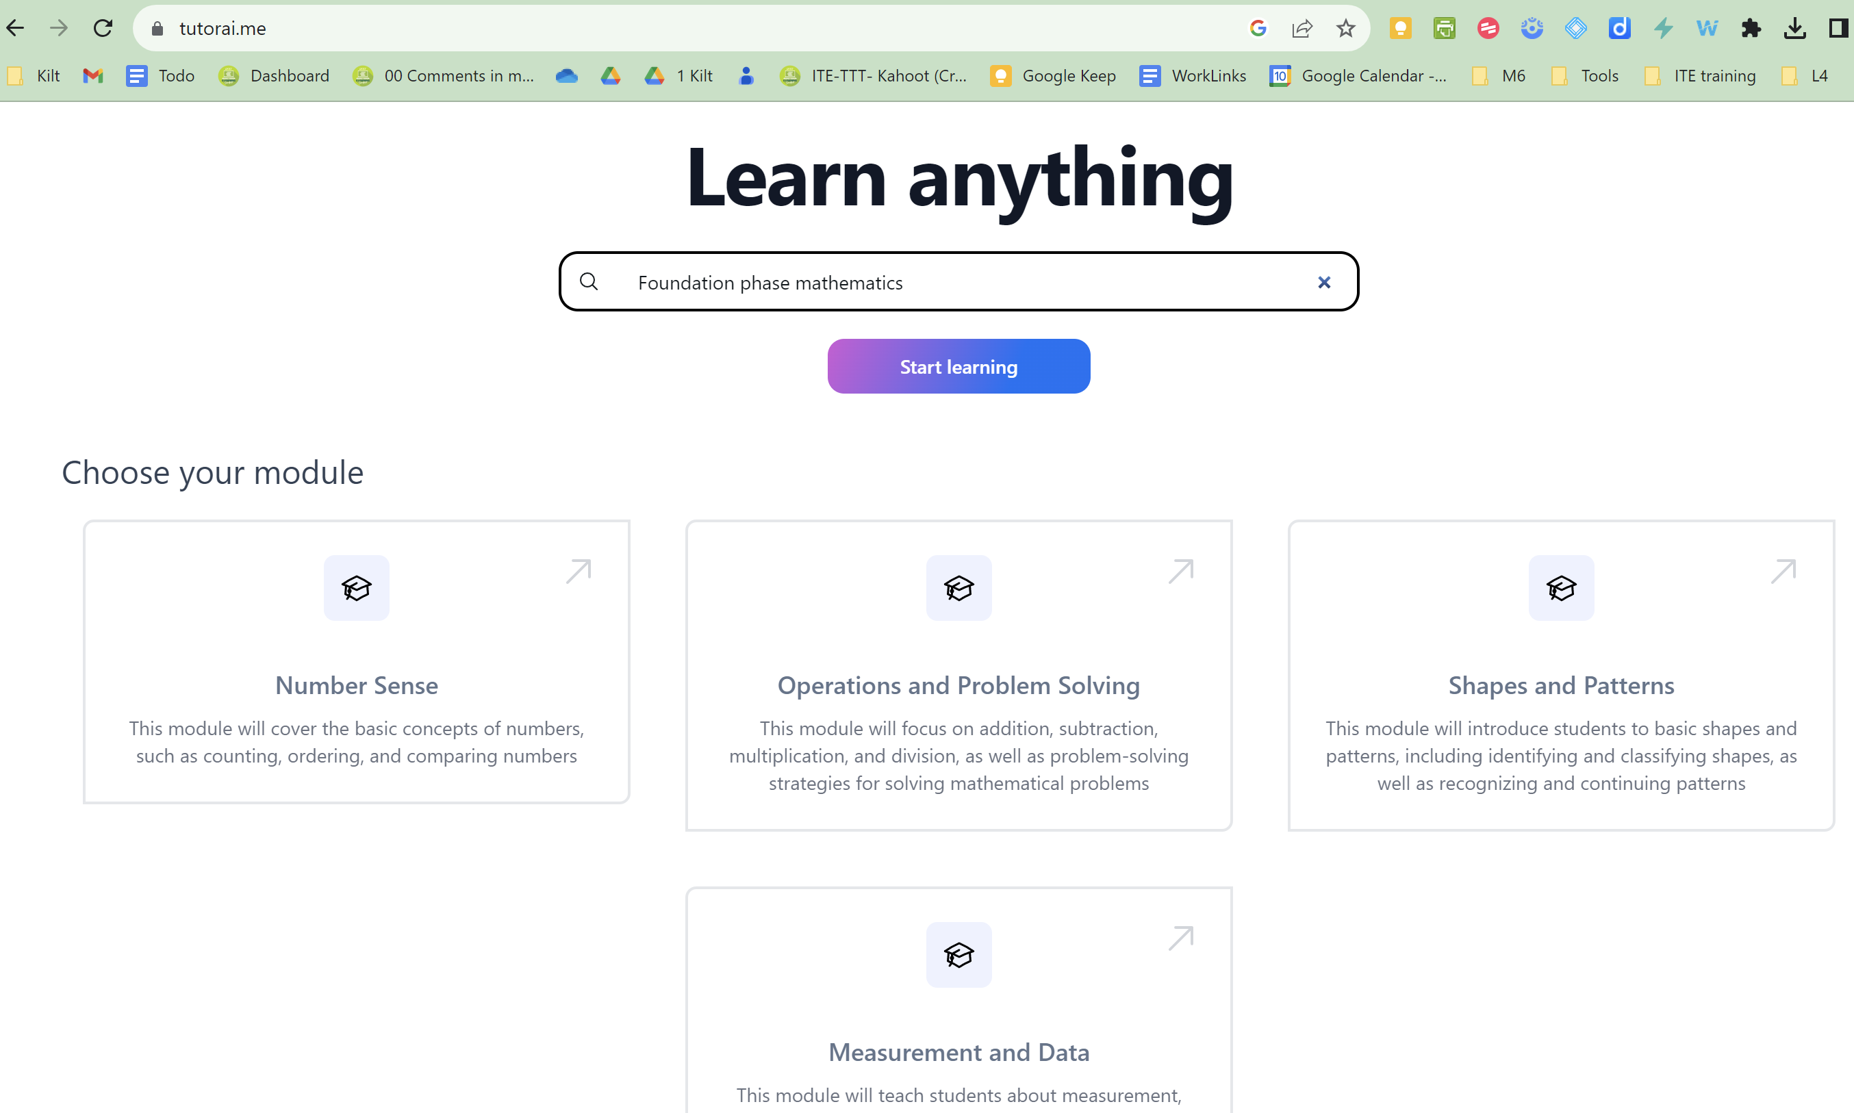

Slide 24
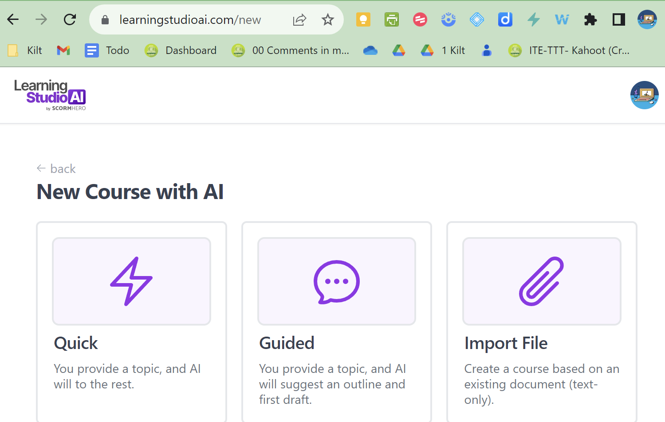
AI in education course

Slide 25
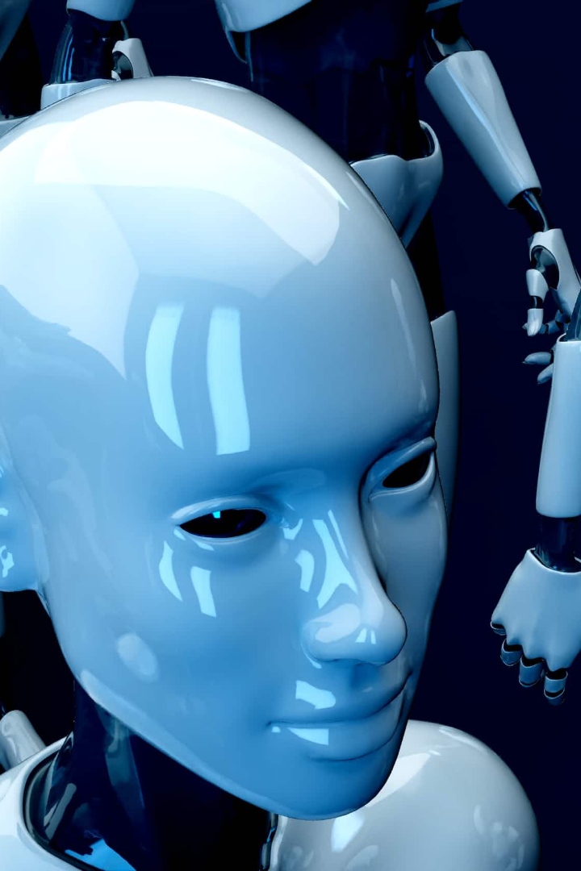
The elephant in the room
Challenges of Implementing AI in Education
1
Learners not critically learning
2
AI scanners
1
Privacy and Security Concerns
2
Ethical Considerations
How accurate are AI scanners? Our learners know how to “Humanize” their AI copied content. How do we beat the crooking?
What do w e do if our learners just copy and paste AI generated content for essays, maths, assignments?
AI's use of personal data raises concerns about privacy, data protection, and ensuring ethical use of student information.
AI decisions, such as grading or recommending courses, must be fair, transparent, and free from bias, requiring careful regulation and oversight.
Cramly.ai
Gptzero.me
3
Our teaching will need to change!
3
We
Teacher Training and Support
If it is possible for our learners to just AI their learning, we will need to change the way we teach, ask questions, and create learning environments for them.
Implementing AI effectively requires providing teachers with the training and support needed to understand and utilize these technologies.

Slide 26
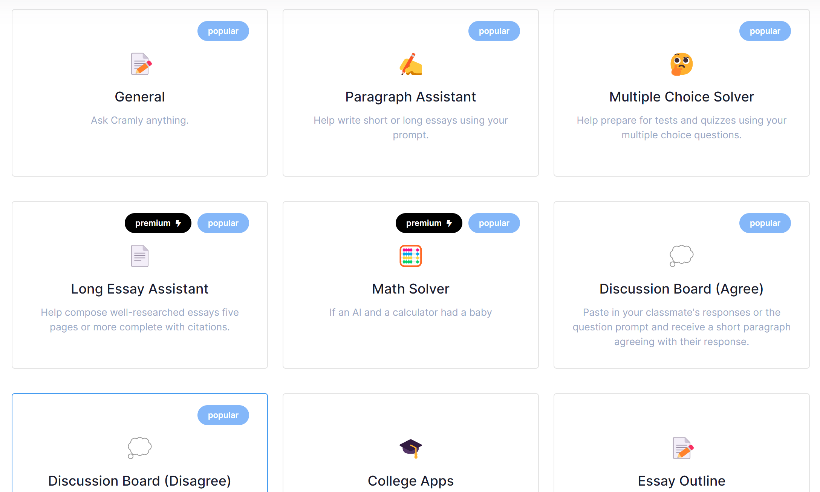
Notes:
https://app.cramly.ai/dashboard

Slide 27
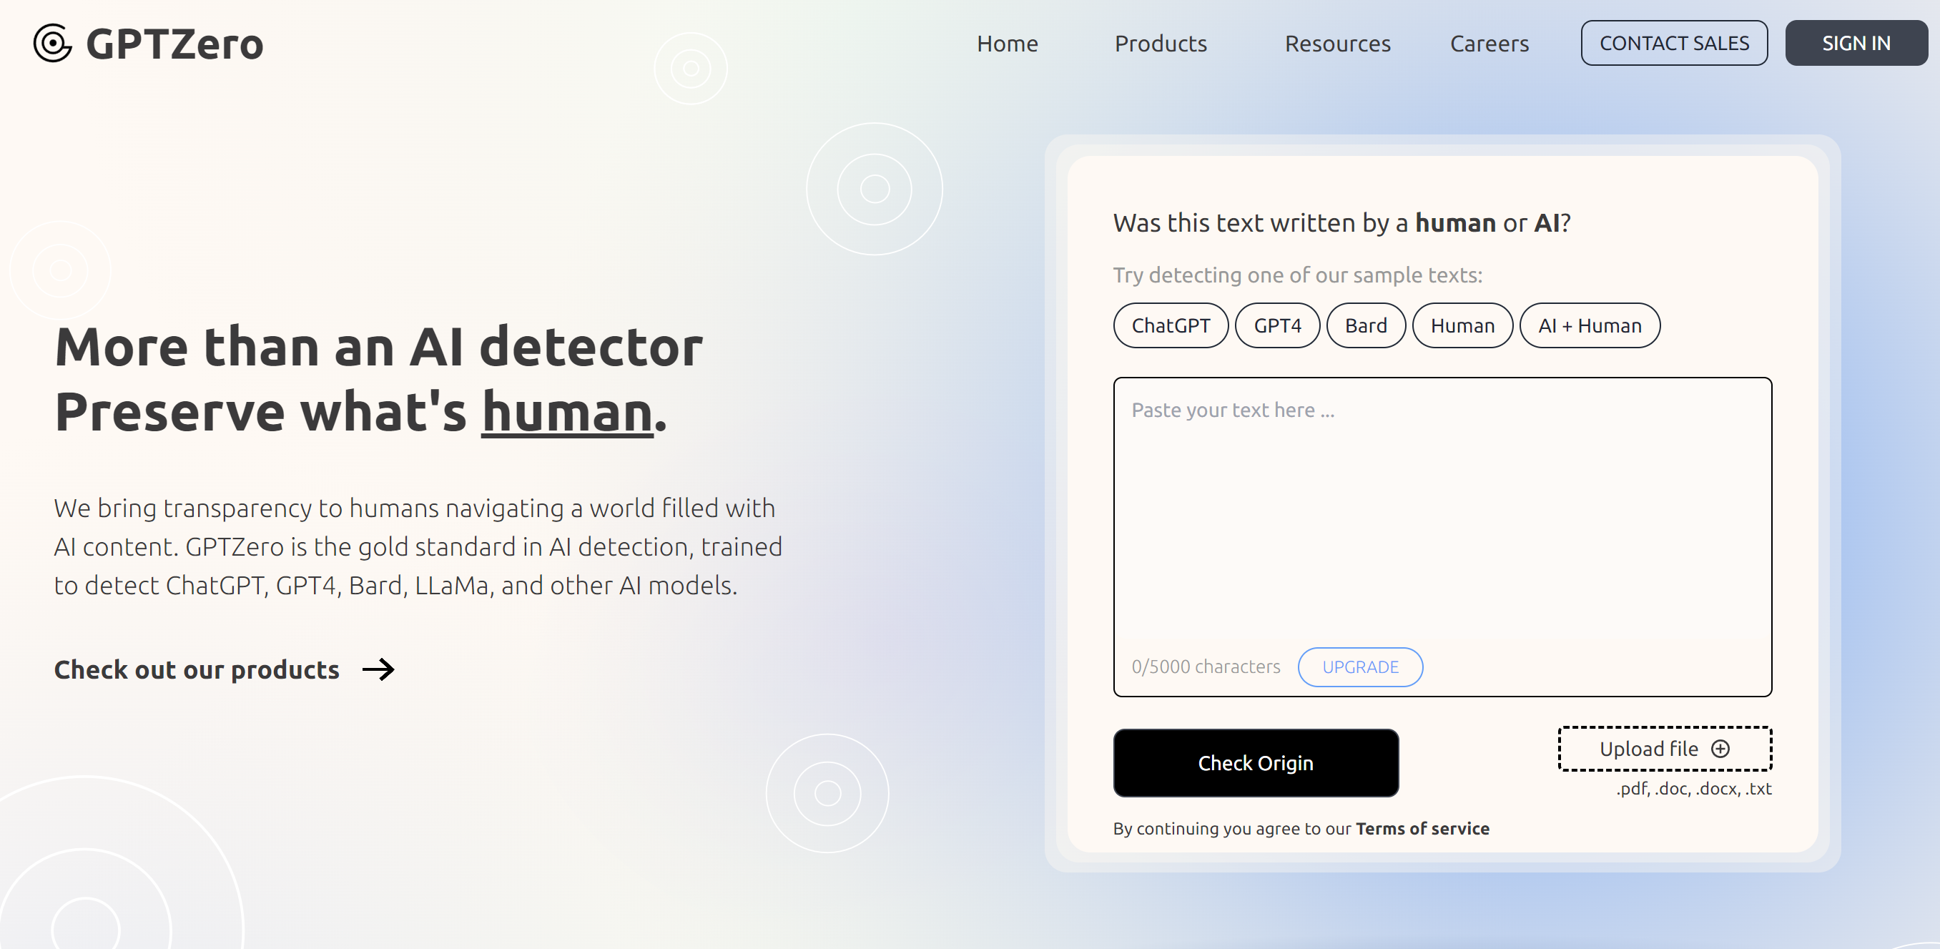
GPTzero.me

Slide 28
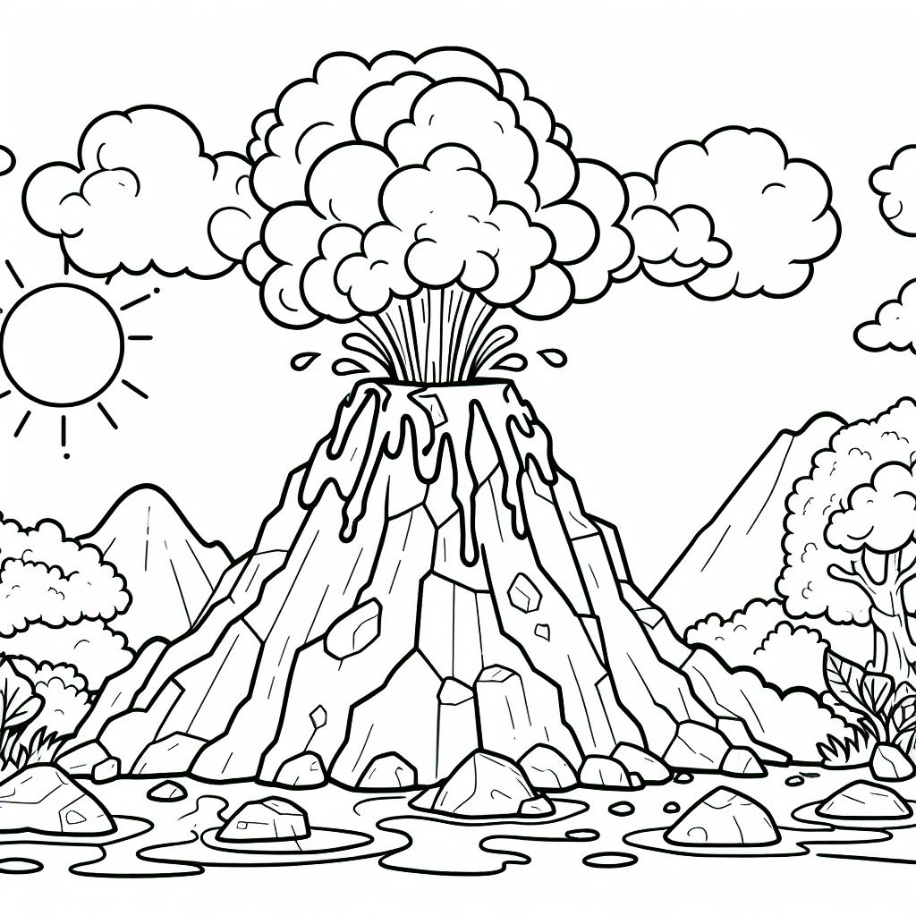
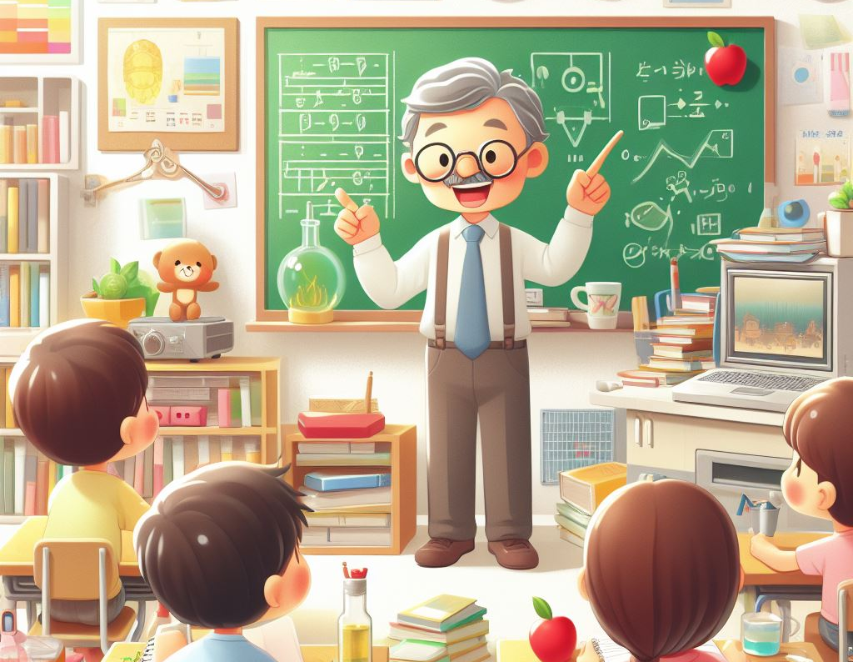
Practical implementation of AI our classrooms
Create a storybook for YOUR context
Let your learners create their own colouring in pictures
AI as a Teacher tool
Self marking tests with AI and Google forms
We are always short of indigenous stories for our own language specific context. So create your own!
AI makes it possible for teachers to create instant lesson plans, assessment tools like multiple choice questions papers and rubrics
Multiple choice is time consuming to create. Let AI do the hard work for you. Add in Google forms and Voila!
Let your learners create what you are teaching and then colour it in.
Teacheraide
Example
You try….
Workshop
Curipod
Notes:
https://www.eduaide.ai/app/assistant

Slide 29
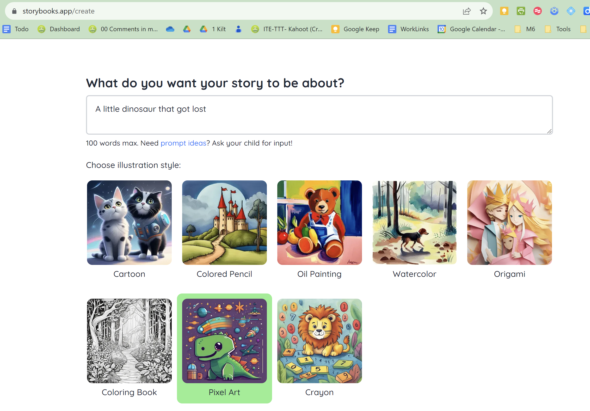

Slide 30
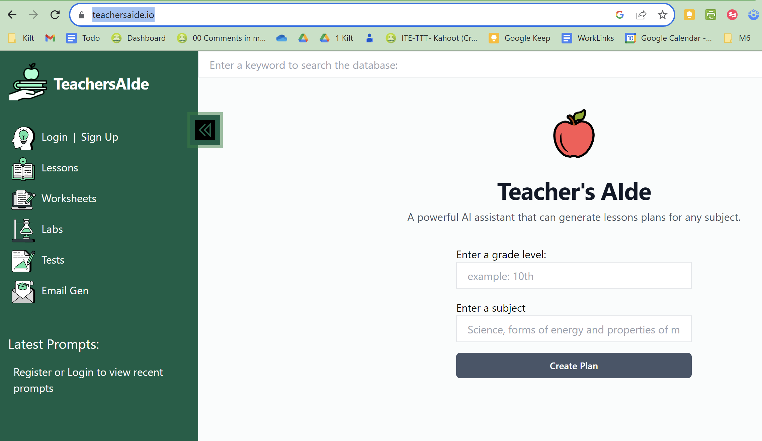
www.teachersaide.io

Slide 31
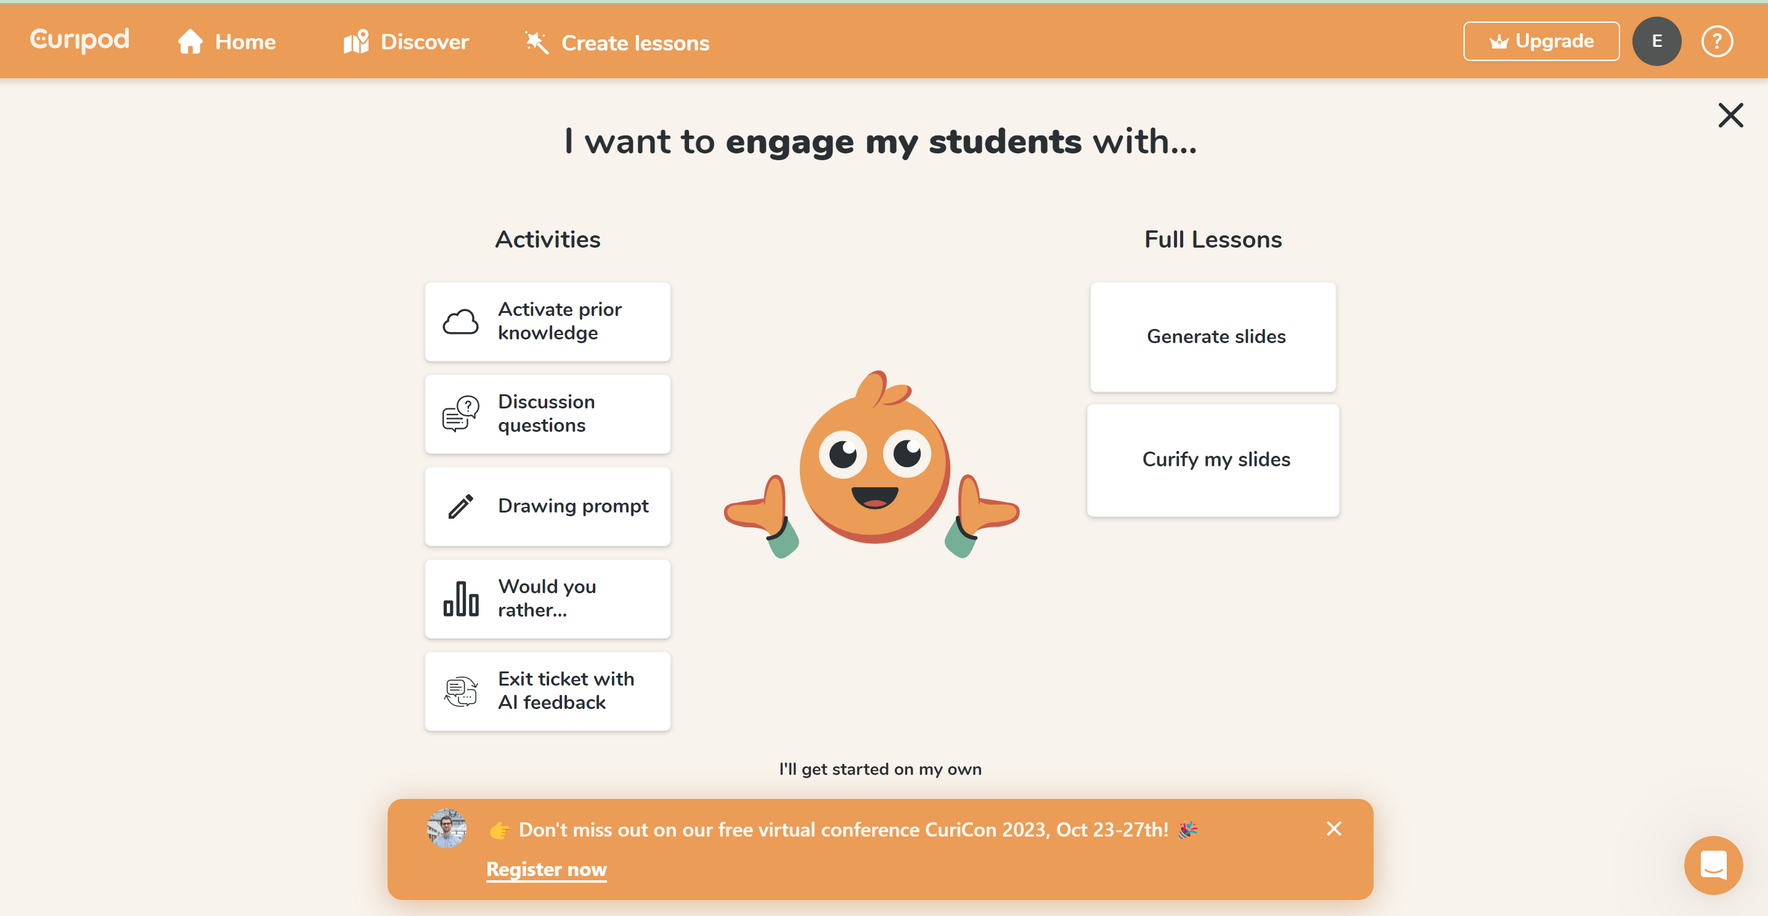
curipod.com

Slide 32
Challenges of Implementing AI in Education
Challenges of Implementing AI in Education
1
Privacy and Security Concerns
2
Ethical Considerations
1
Privacy and Security Concerns
2
Ethical Considerations
AI's use of personal data raises concerns about privacy, data protection, and ensuring ethical use of student information.
AI decisions, such as grading or recommending courses, must be fair, transparent, and free from bias, requiring careful regulation and oversight.
AI's use of personal data raises concerns about privacy, data protection, and ensuring ethical use of student information.
AI decisions, such as grading or recommending courses, must be fair, transparent, and free from bias, requiring careful regulation and oversight.
3
Teacher Training and Support
3
Teacher Training and Support
Implementing AI effectively requires providing teachers with the training and support needed to understand and utilize these technologies.
Implementing AI effectively requires providing teachers with the training and support needed to understand and utilize these technologies.

Slide 33
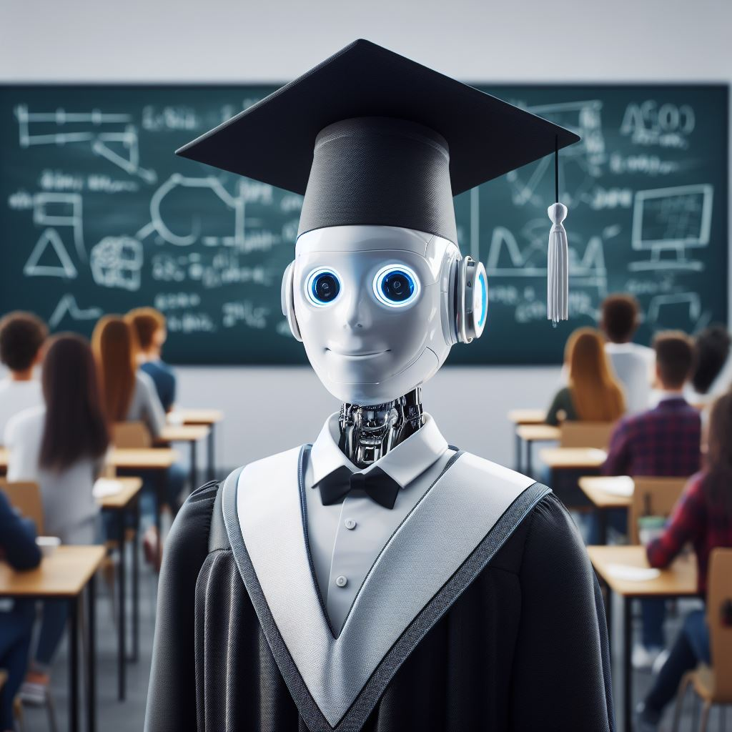
More resources
Challenges of Implementing AI in Education
Join our AI wakelet
ECKED AI Wakelet
KILT e-Learning AI collection
KILT e-Learning Wakelet
Sign our exit ticket and get your copy of our latest list of Teachers AI tools
Exit ticket

Slide 34
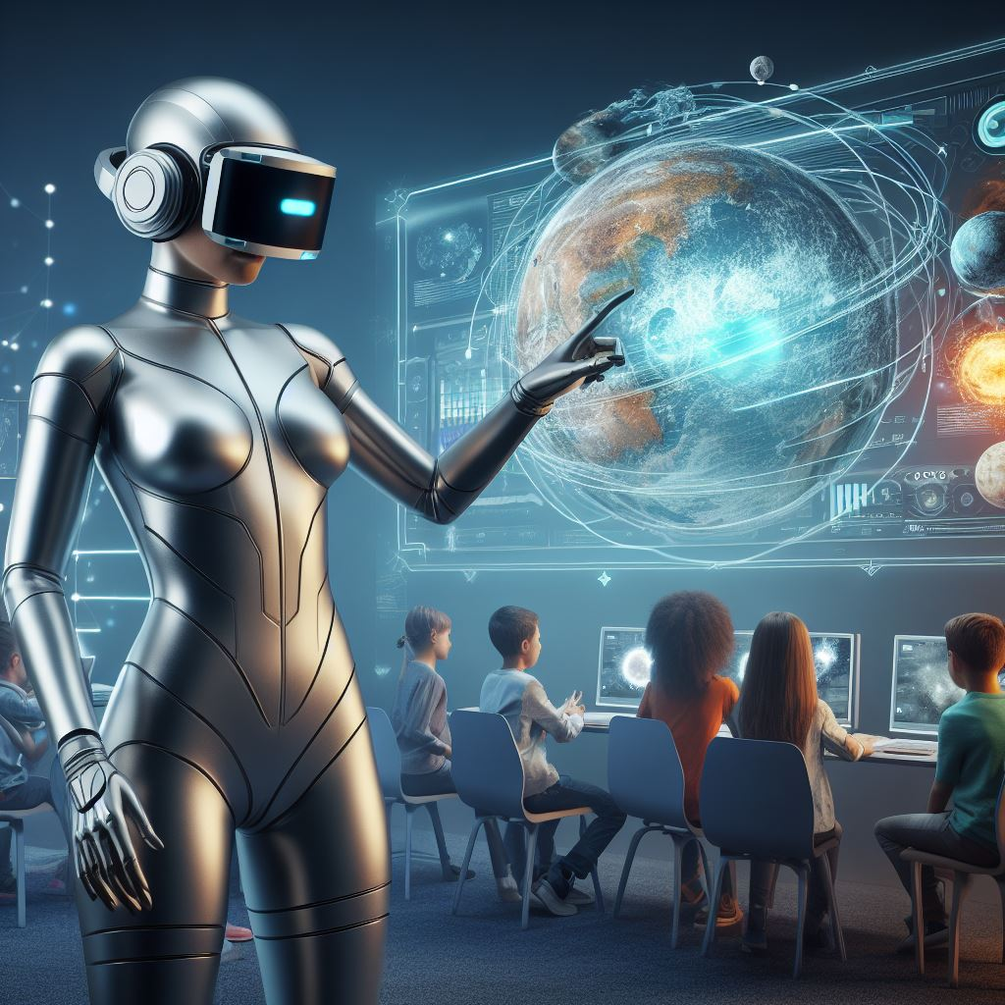
Conclusion
Embracing AI in education has the potential to revolutionize student learning, improve outcomes, and empower teachers. Let's embrace this transformative technology for the future of education.
Thank You
Memory Dizha
memory.DIzha@westerncape.gov.za Maggie Verster maggiev@kilt.org.za
www.klearning.co.za
Notes:
https://paradoxlearning.com/wp-content/uploads/2023/10/AI-Literacy-Competency-Framework-for-Educators.pdf

